Slide 1
Cloud Native Development Platform
Accelerating Cloud Software Delivery and Unifying DevOps

Slide 2
About Pulumi
Delivering Cloud Native Infrastructure as Code
Accelerating Cloud Migration and DevOps
CODE
Config as Code
Code is the most expressive way to create applications and infrastructure, sharing and reusing real components.
All developers have become cloud developers, and need a programming model for the cloud.
CLOUD
Cloud Native Architecture
Emerging cloud architectures combine containers, serverless functions, and data services & infrastructure.
Multi-cloud development is a reality that developers must integrate into their architectures, tools, and processes.
COLLABORATION
Unified Dev and DevOps
Teams can collaborate better, breaking down silos, when they share common languages and tools.
Productivity is enhanced when teams can leverage existing cloud-agnostic skill sets to get the job done.

Slide 3
Cloud Evolution Challenges
The cloud is pushing towards increasing statelessness and ephemerality.
MARKET
ADOPTION
Each evolution produces new solutions which means more tools, DSLs, and workflows to support.
CONFIGURATION DSL SPRAWL
Too many cloud vendor-specific, or technology specific templating languages.
INCREASING TEAM SILOS
Lack of a common approach means Dev and DevOps struggle to collaborate.
CNI ‘IN MOTION’ vs ‘AT REST’
Ephemerality means CD matters more than CI, provisioning matters more than configuration.
THE RISK OF LOCK IN
Using innovative cloud services means lock-in to a specific cloud.
STATEFUL
Applications
STATELESS
PERSISTENT
Infrastructure
EPHEMERAL
v1
v2
v3
Infrastructure
VMs
Cloud Native
Containers
Kubernetes
Functions
Serverless
Managed Services

Slide 4
What is Pulumi?
Cloud Native Infrastructure as Code
Real language to deliver any app, on any cloud
CLOUD NATIVE SDK
Open Source Tools and Framework
A multi-language, multi-cloud open source SDK for modern cloud native software with containers, serverless, and hosted infrastructure.
The power of infrastructure as code, the flexibility of real languages you know and love, with reusable packages.
CLOUD DELIVERY PLATFORM
Team and Enterprise SaaS
A platform for engineers to collaborate and promote infrastructure changes safely and predictably.
Finally, Dev and DevOps meet on common ground with flexible workflows and policies for teams of all sizes.

Slide 5










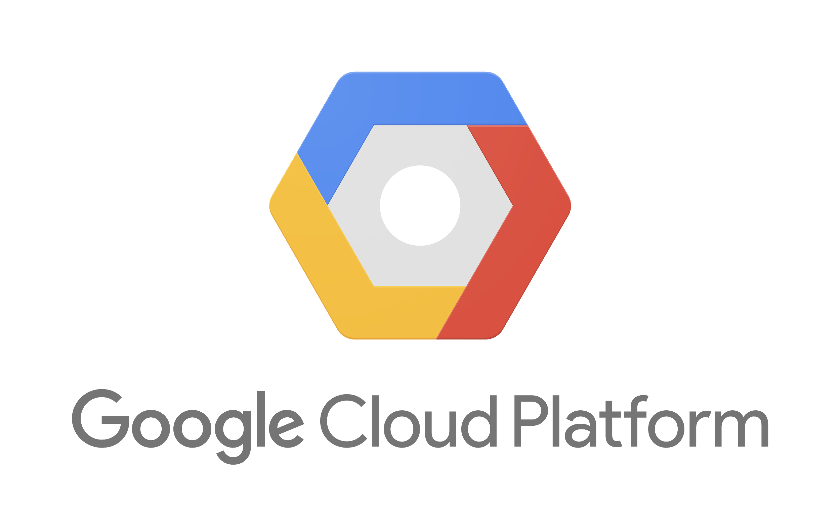
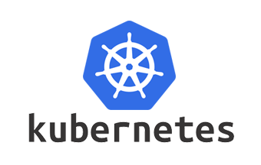







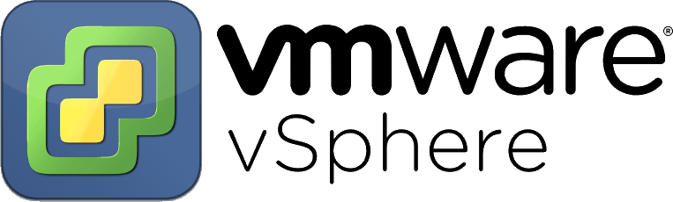
Get code to the cloud. Faster.
CODE
CODE
CLOUD SDK
DEPLOY
PROVIDERS
MANAGE
SERVICE
CLOUD
SOURCE CODE
LANGUAGES
TOOLS
ENVIRONMENTS

Slide 6


Thank You
https://www.pulumi.com/
team@pulumi.com
@PulumiCorp

